Slide 1
Activity 2 review & Introduction to power analysis
Dr Andy Fugard
a.fugard@ucl.ac.uk
28th November 2016

Slide 2
Objectives
Review your answers from activity 2
Understand simple and standardised effect size
Understand and be able to carry out a power analysis for
Between-participant t-tests
Pearson’s correlation

Slide 3
Review part A

Slide 4
1. Which of the SDQ variables would you expect to be correlated with which Bullying measures?

Slide 5
Example
At pre-intervention, reports of peer difficulties will be related to peer-rated bullying behaviours

Slide 6
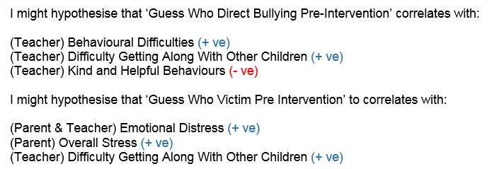
Another…

Slide 7
And another
I would expect the ‘direct bullying’ measure to be positively correlated with SDQ Self, Parent and Teacher report of behavioural difficulties (conduct) pre intervention and difficulties getting along with other children (peer difficulties) pre intervention, and to be negatively correlated with kind and helpful behaviour (prosocial) pre intervention.

Slide 8
Different kinds of hypothesis
Substantive hypotheses
what EPs and researchers primarily care about!
refer to terms in psychological theory
often will be specify a direction, e.g., your new intervention is better than others’
Statistical hypotheses
necessary evil; nothing to be proud of
referring to means, correlations, ...
it might well be 2-tailed even if one above is directional

Slide 9

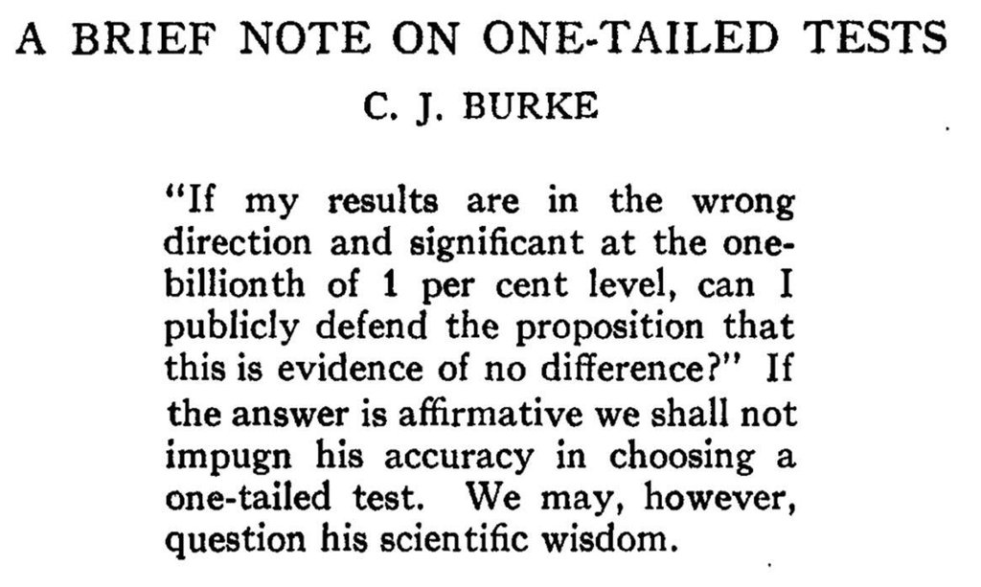

Slide 10
2. Test your hypotheses using non-parametric tests; what do you find?
Report all correlations and full p’s, even if not statistically significant
Non statistically significant results are useful for meta-analysts

Slide 11
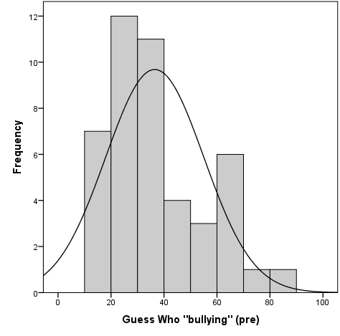
Can we use Pearson’s correlation? Nope
Before looking at the data guessed it would be skewed since most classes will (should?!) have few bullies.
Surprised by no zeros, but read abstract again!
Confirmed by eyeballing and formal tests, e.g., Shapiro-Wilk W = .92, p = .004 for bully scores

Slide 12
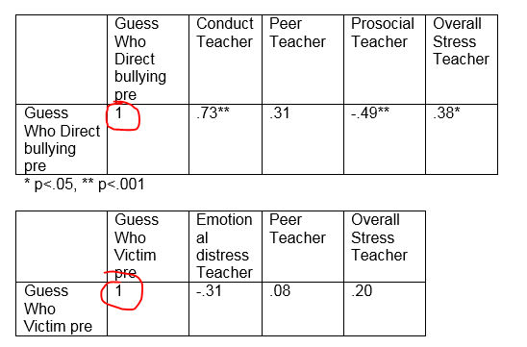

Slide 13
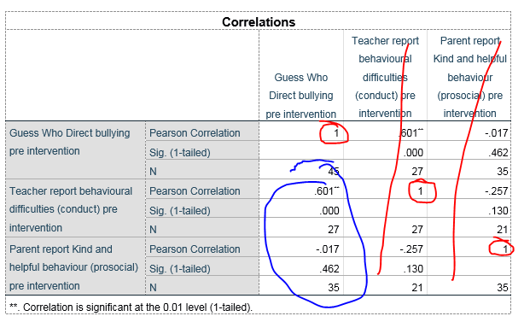

Slide 14
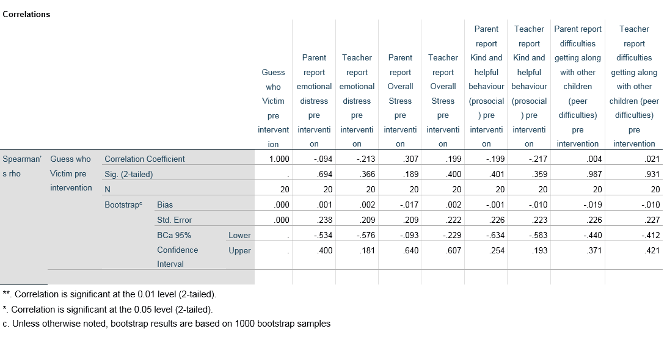

Slide 15
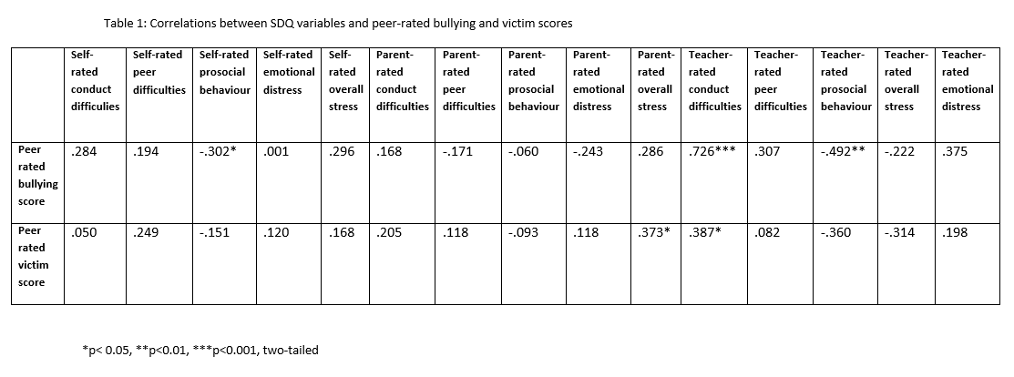

Slide 16
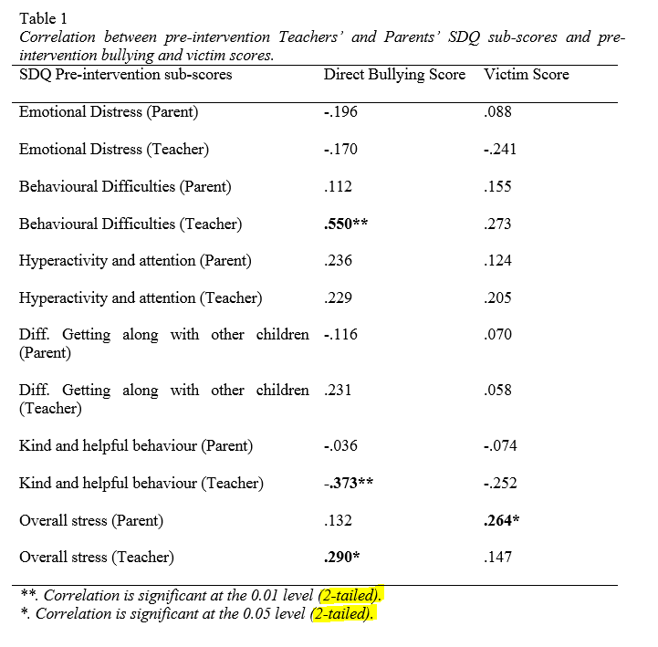

Slide 17
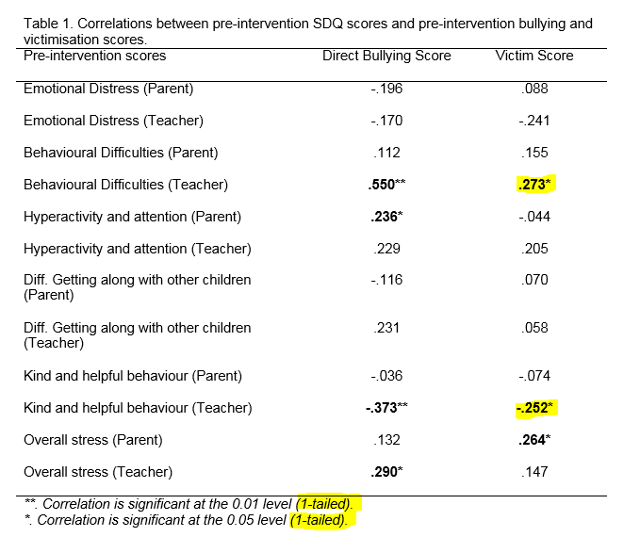

Slide 18
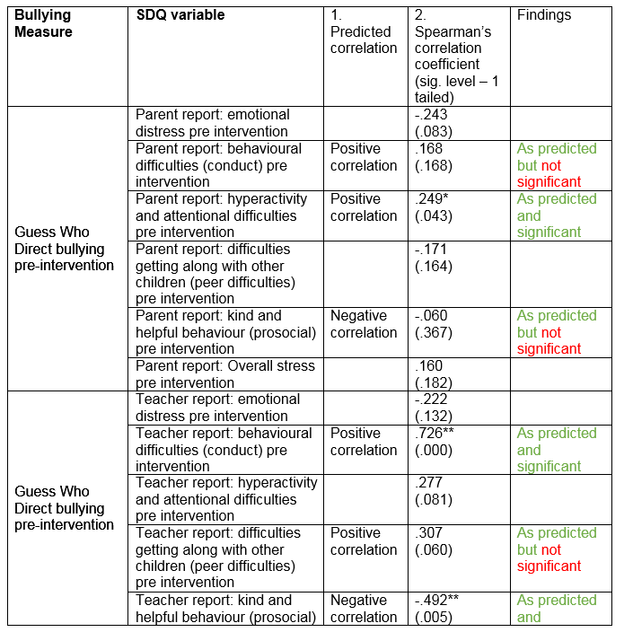

Slide 19
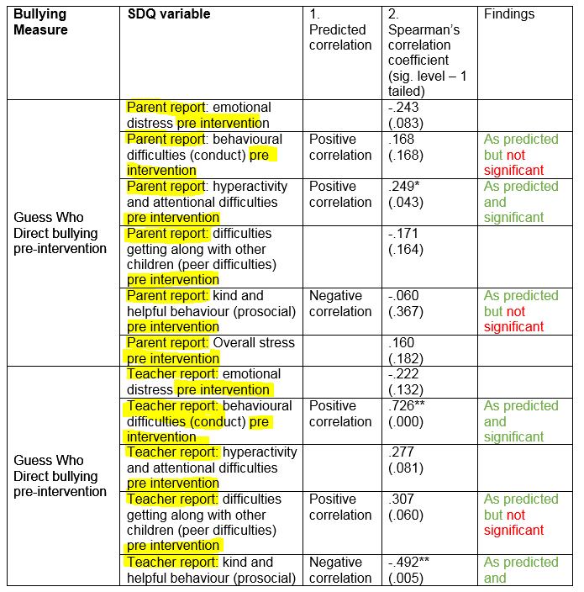

Slide 20
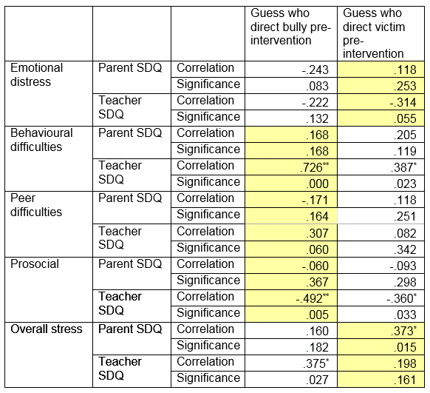

Slide 21
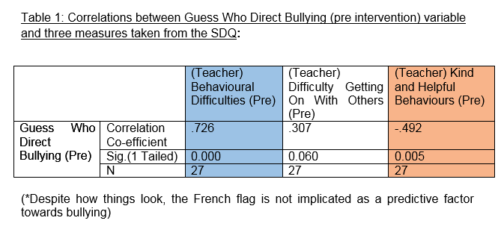
Vive la révolution

Slide 22
 | A1 | A2 | A3 | A4 | A5 | C1 | C2 | C3 | C4 | C5 | E1 | E2 | E3 | E4 | E5 | N1 | N2 | N3 | N4 | N5 | O1 | O2 | O3 | O4
A2 | 12
A3 | 7 | 25
A4 | 2 | 12 | 15
A5 | 4 | 16 | 27 | 11
C1 | 0 | 1 | 1 | 1 | 2
C2 | 0 | 2 | 2 | 5 | 1 | 19
C3 | 0 | 4 | 2 | 2 | 2 | 10 | 13
C4 | 1 | 2 | 1 | 3 | 2 | 13 | 16 | 13
C5 | 0 | 1 | 2 | 6 | 3 | 7 | 9 | 12 | 24
E1 | 1 | 5 | 4 | 2 | 6 | 0 | 0 | 0 | 1 | 0
E2 | 1 | 6 | 9 | 4 | 11 | 1 | 1 | 1 | 4 | 7 | 22
E3 | 0 | 7 | 15 | 4 | 17 | 2 | 2 | 1 | 1 | 3 | 10 | 15
E4 | 0 | 9 | 15 | 10 | 23 | 2 | 2 | 1 | 1 | 4 | 18 | 28 | 17
E5 | 0 | 9 | 6 | 3 | 7 | 7 | 7 | 4 | 6 | 6 | 9 | 15 | 15 | 10
N1 | 3 | 1 | 1 | 1 | 4 | 1 | 0 | 1 | 5 | 5 | 0 | 3 | 0 | 2 | 0
N2 | 2 | 0 | 1 | 2 | 4 | 0 | 0 | 0 | 3 | 6 | 0 | 4 | 0 | 2 | 0 | 52
N3 | 1 | 0 | 0 | 1 | 2 | 0 | 0 | 1 | 4 | 6 | 0 | 4 | 0 | 2 | 0 | 32 | 30
N4 | 0 | 1 | 2 | 3 | 5 | 1 | 0 | 1 | 7 | 13 | 6 | 12 | 2 | 9 | 4 | 17 | 16 | 27
N5 | 0 | 0 | 0 | 0 | 1 | 0 | 0 | 0 | 4 | 3 | 0 | 7 | 1 | 1 | 2 | 14 | 12 | 19 | 16
O1 | 0 | 2 | 2 | 0 | 3 | 3 | 3 | 1 | 1 | 1 | 1 | 3 | 11 | 2 | 8 | 0 | 0 | 0 | 0 | 2
O2 | 0 | 0 | 0 | 0 | 0 | 2 | 0 | 0 | 4 | 2 | 0 | 1 | 1 | 0 | 1 | 2 | 1 | 1 | 1 | 3 | 5
O3 | 0 | 3 | 5 | 1 | 6 | 4 | 4 | 0 | 1 | 1 | 5 | 6 | 17 | 5 | 9 | 0 | 0 | 0 | 0 | 1 | 15 | 8
O4 | 1 | 1 | 0 | 0 | 0 | 1 | 0 | 0 | 0 | 2 | 1 | 3 | 0 | 1 | 0 | 1 | 2 | 3 | 5 | 1 | 3 | 1 | 3
O5 | 1 | 1 | 0 | 0 | 0 | 2 | 0 | 0 | 4 | 0 | 1 | 1 | 2 | 0 | 1 | 1 | 0 | 0 | 0 | 2 | 6 | 11 | 10 | 3

Slide 23
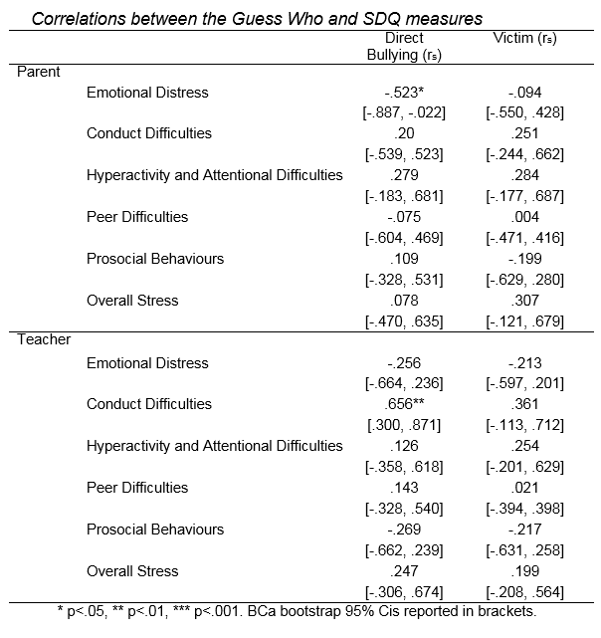
This way is fun

Slide 24
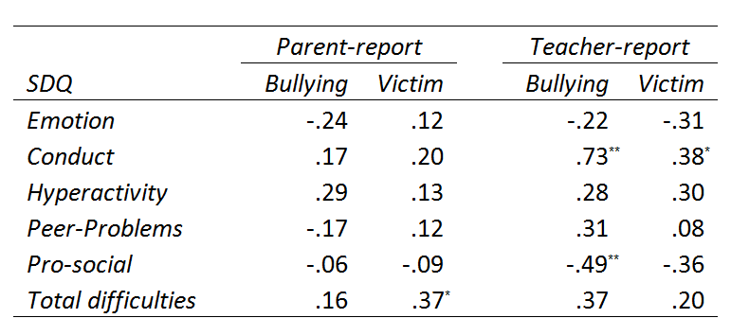
Another possible answer
Table 1. Spearman’s r_{s} correlations between Parent/Teacher SDQ and
Guess Who scores.
Note: * p < .05, ** p < .01

Slide 25
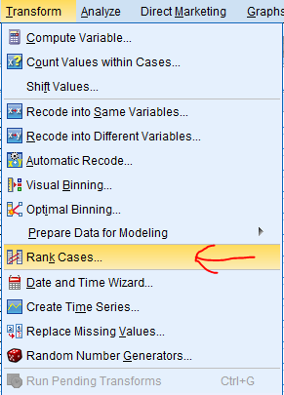
Rho vs. tau in a slide
Spearman’s rho: Pearson’s correlation between ranks (but with new formula for p-values)
Kendall’s tau:
Proportion of pairs in same order – pairs in reverse order
Worth knowing as it’s used in single case analyses too
(Tau-U and Baseline Corrected Tau)

Slide 26
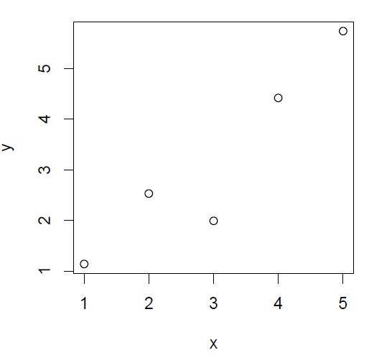

Slide 27
+ve
1
-ve
0

Slide 28
+ve
2
-ve
0

Slide 29
+ve
3
-ve
0

Slide 30
+ve
4
-ve
0

Slide 31
+ve
4
-ve
1

Slide 32
+ve
5
-ve
1

Slide 33
+ve
6
-ve
1

Slide 34
+ve
7
-ve
1

Slide 35
+ve
8
-ve
1

Slide 36
+ve
9
-ve
1

Slide 37
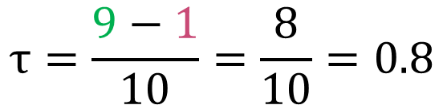
+ve
9
-ve
1
$$τ=\frac{9−1}{10}=\frac{8}{10}=0.8$$

Slide 38
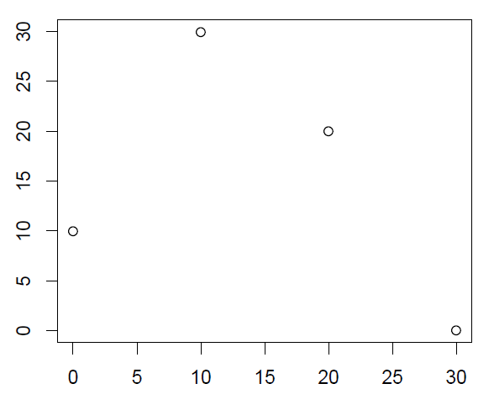
What about this one?

Slide 39
Aside
Tau is an example effect size

Slide 40
Review part B

Slide 41
3. Has there been a reduction in bullying as measured by the “Guess Who Direct bullying” measure, pre- and post- intervention in either group?

Slide 42
For the intervention group, the Guess Who Direct bullying measure was significantly higher pre intervention than for post intervention, z=-2.58, p<.05, r=-.039. For the comparison group there was no significant difference in pre and post measures for the guess who direct bullying measure.

Slide 43
For the intervention group, direct bullying scores were significantly lower after the intervention (Mdn = 22.35), than before the intervention (Mdn = 31.40), z = -2.581, p=0.01 (two tailed), r = -0.39. This is a medium effect size according to Cohen’s criteria.

Slide 44
Don’t forget the name of the test
A Wilcoxon related-samples test showed that the bullying intervention under investigation yielded a statistically significant decrease in a measure of bullying, comparing pre intervention scores to post intervention scores (Z = -2.581, p = 0.01).

Slide 45
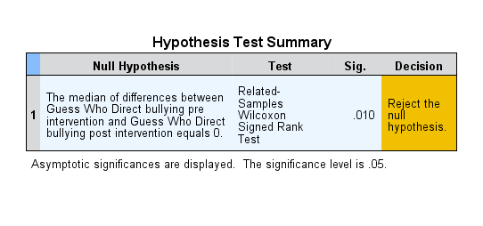
Fun with SPSS – double click for detail

Slide 46
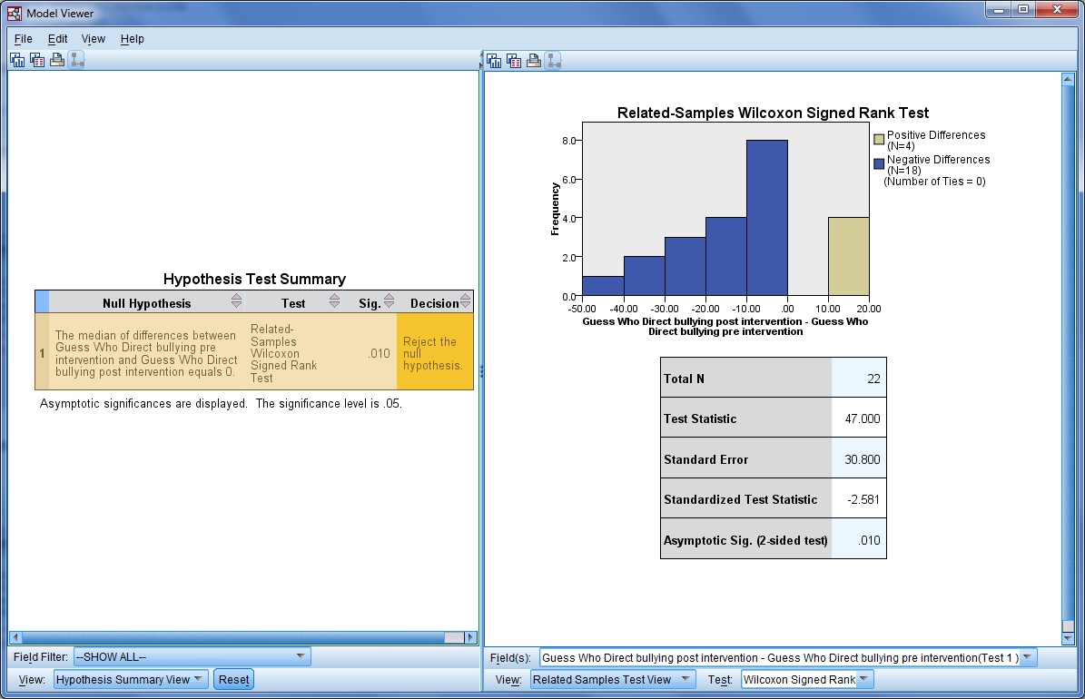
Fun with SPSS – double click for detail

Slide 47
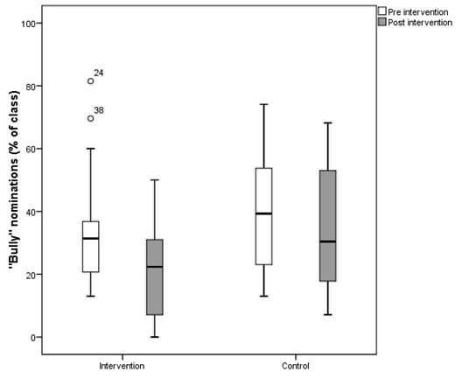
Possible answer
There was a statistically significant decrease in percentage of “bully” nominations for the intervention group (Wilcoxon signed rank test z = -2.6, p = .010, r = -.39) but not for the control group (z = -1.8, p = .075, r = -.27).

Slide 48
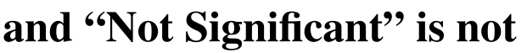

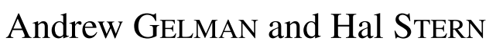

Slide 49
A note on p-values
Include the whole value, e.g., “p = .048” rather than “p < .05”
Current APA exception: if p < .001, so don’t write p = .000
Always alongside the statistic, e.g., t, z, F

Slide 50
Review part C

Slide 51
4. Make a contingency table to examine the relationship between these variables (Descriptive Statistics… Crosstabs). What do you notice?

Slide 52
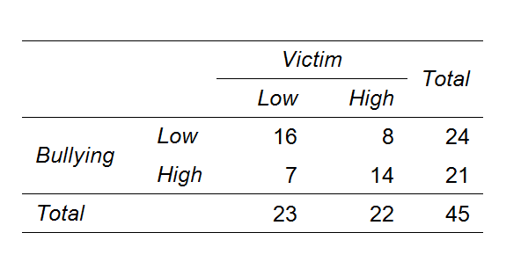
One way to present the results
An association was found between Guess Who “victim” and “bully” median split classifications, χ²(1, N = 45) = 4.98, p = .026

Slide 53
But where are observed values different to those expected by chance?
Answer: adjusted standardised residuals (also in crosstab)
These are z scores, so p < .05 if over 1.96 or less than -1.96

Slide 54
6… is there a statistically significant difference in original continuous Guess Who Direct Bullying pre score between high/low victim categories?

Slide 55
The direct bullying scores are significantly different between the below group (Mdn = 12.5) and the above group (Mdn = 35) statistically, U = 504, z = 5.74, p <.001, r = .86.
Distribution of peer-rated bullying behaviour in those peer-rated as victims (Mdn = 38.40) did significantly differ from those not peer-rated as victims (Mdn = 28.60), U = 372, z = 2.704, p = .007, r = .40.

Slide 56
(Looking more closely at the results of the analysis, the data suggests that children who were placed in the high victim category of bullying were rated higher on the Guess Who Direct Bullying pre-intervention measure. This suggests that if you are a victim of bullying, you may be more likely to bully others).

Slide 57
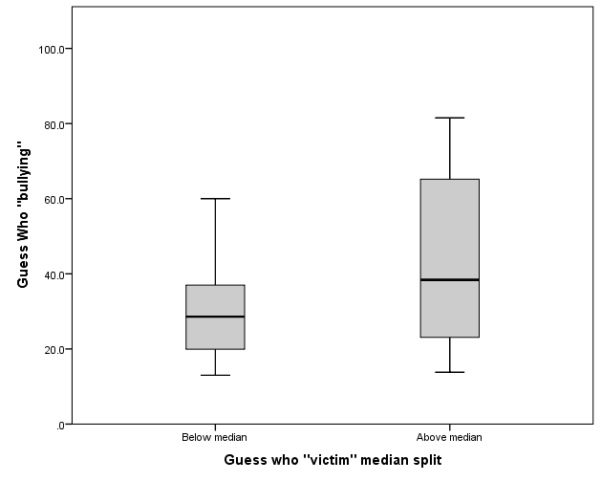
Participants with a “victim” score above the median had higher “bully” ratings than those below the median (U = 372, z = 2.7, p = .007, r = .40).

Slide 58
“The term nonparametric may have some historical significance and meaning for theoretical statisticians, but it only serves to confuse applied statisticians.”
(Noether, 1984)

Slide 59
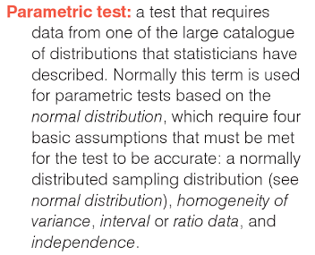
Hmmm okay… but not always!

Slide 60
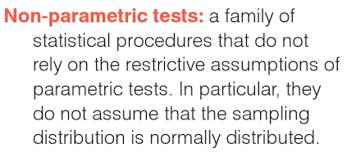

Slide 61
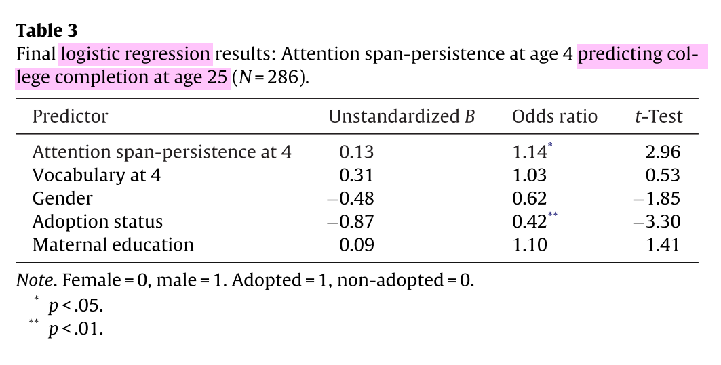
McClelland, M. M., Acock, A. C., Piccinin, A., Rhea, S. A., & Stallings, M. C. (2013). Relations between preschool attention span-persistence and age 25 educational outcomes. Early Childhood Research Quarterly, 28, 314–324.

Slide 62
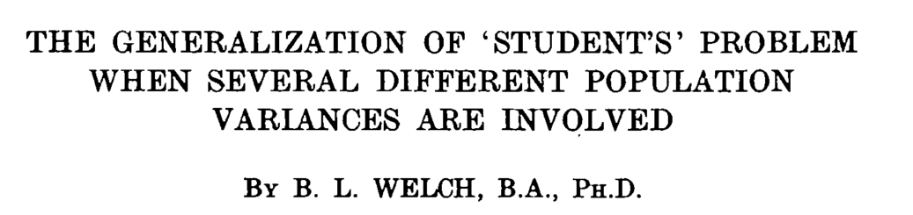
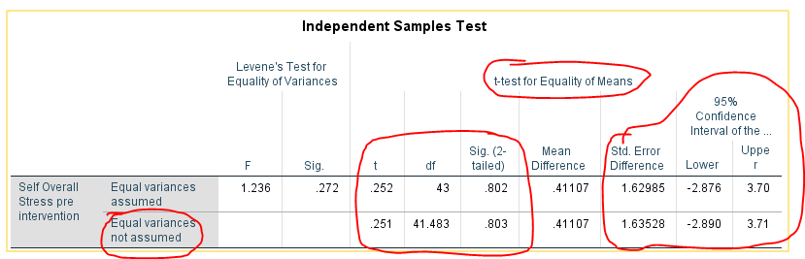
(1947)

Slide 63
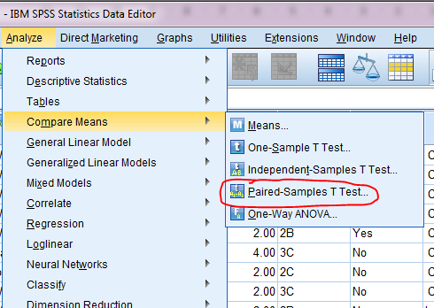

Slide 64
Power analysis

Slide 65

“An astronomer does not know the magnitude of new stars until they have found them, but the magnitude of star they are looking for determines how much they have to spend on a telescope.”
Senn, S. J. (2002)
BMJ, 325, 1304–1304

Slide 66
What’s power analysis about?
Used to help decide your sample size
Derived from the effect size you hope to find
And the power of your study:
how sure you want to be of finding something if it’s out there to be found, i.e., how risk aversive you are!
Low power = big gamble
First we need to know about effect size…

Slide 67
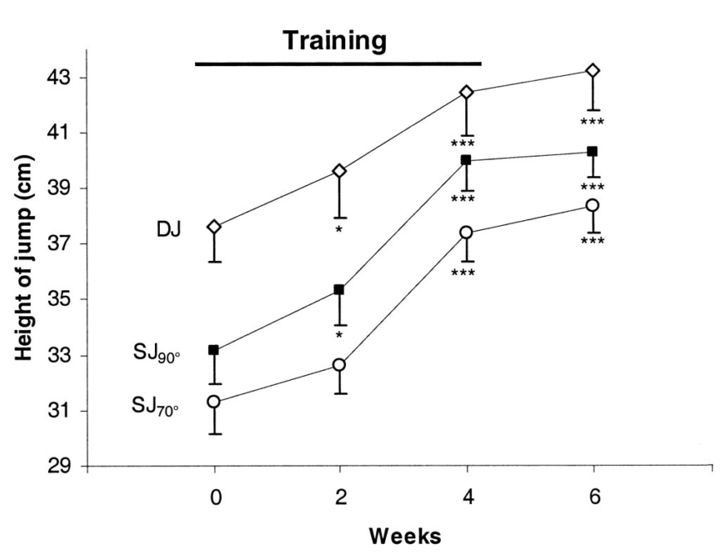
Made up example of a simple effect size: effect of mindfulness training on vertical jump height
This shows the simple effect size: average increase in jump height
Notes:
Graph (for another intervention) from Maffiuletti et al (2002)

Slide 68
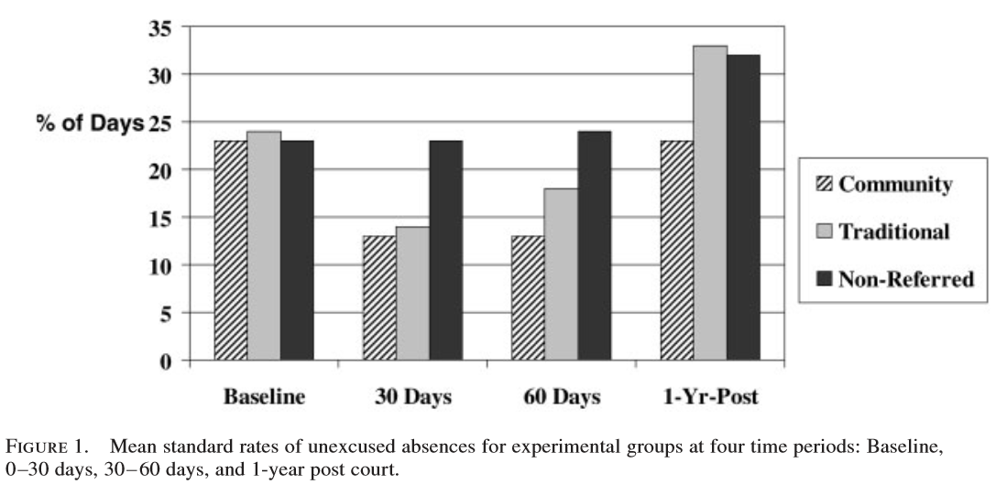
Real example: trying to reduce school absences (Fantuzzo, Grim & Hazan, 2005)

Slide 69
Real example: trying to reduce school absences (Fantuzzo, Grim & Hazan, 2005)
Roughly equivalent

Slide 70
Real example: trying to reduce school absences (Fantuzzo, Grim & Hazan, 2005)
Simple effect = 22 – 13 = 9

Slide 71
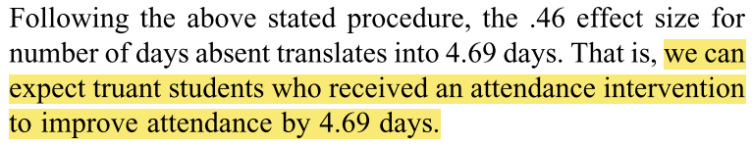
Average improvement in attendance (Maynard, McCrea, Pigott & Kelly, 2012)
on average!

Slide 72
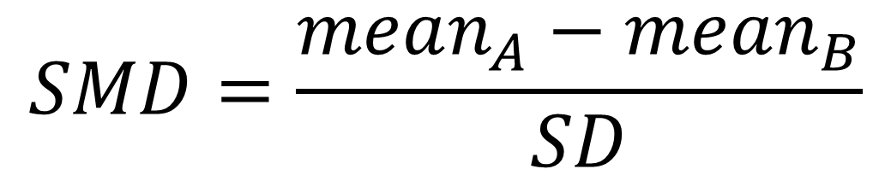
Standardised mean difference (SMD) between two normally distributed groups
Difference in means
$$SMD=\frac{mean_{A}−mean_{B}}{SD}$$

Slide 73
Standardised mean difference (SMD) between two normally distributed groups
$$SMD=\frac{mean_{A}−mean_{B}}{SD}$$
Divided by the standard deviation

Slide 74
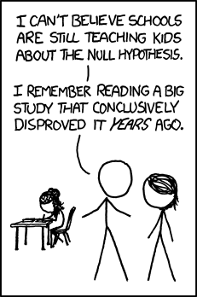
Arithmetical Activity
Bloggs et al. (2014) ran an RCT evaluating whether including XKCD cartoons in teaching reduces statistics anxiety. At the end of the study, the control group had a mean anxiety score of 5 (out of 10) and the XKCD group had a mean of 3. The SD = 4. What is the standardised mean difference?

Slide 75
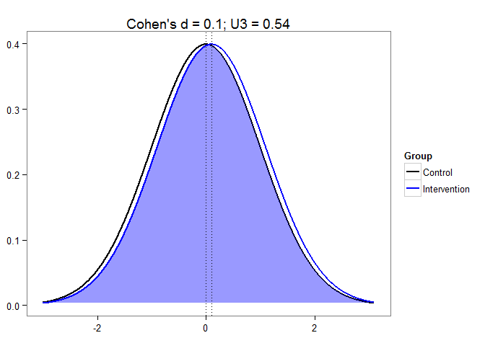
Example: Cohen’s d – example of an SMD

Slide 76
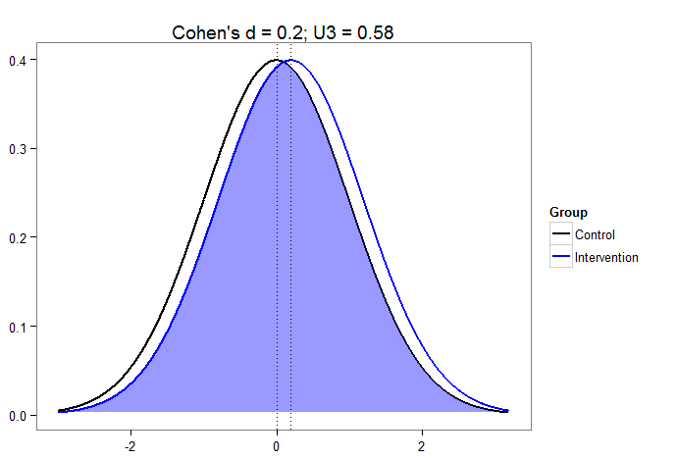
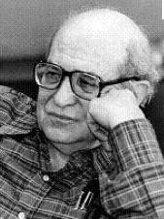
small

Slide 77
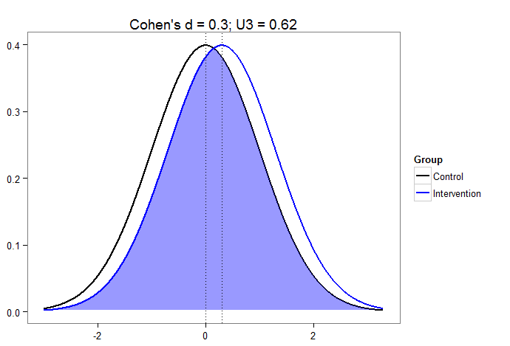

Slide 78


Slide 79
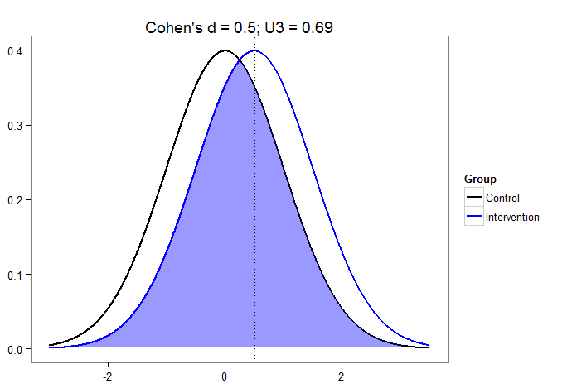
medium

Slide 80
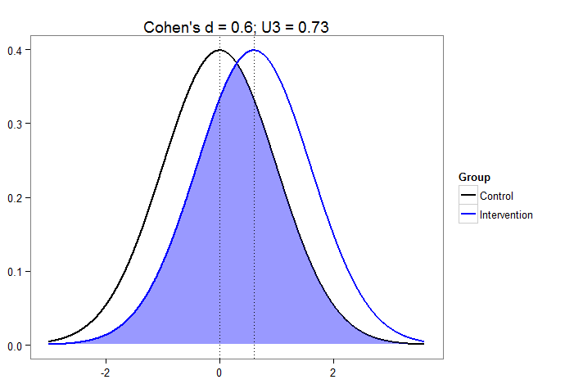

Slide 81


Slide 82
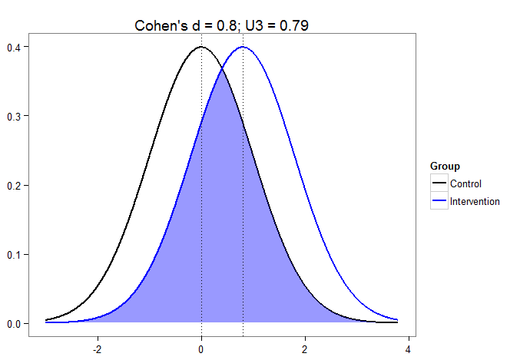
LARGE!

Slide 83
How did Cohen (1988) arrive at these interpretations? It wasn’t particularly rigorous…
Small: mean difference in height between 15- and 16-year olds
Medium: based on hypotheses about social class differences in IQ
Large: mean difference in height between 13- and 18-year-olds

Slide 84
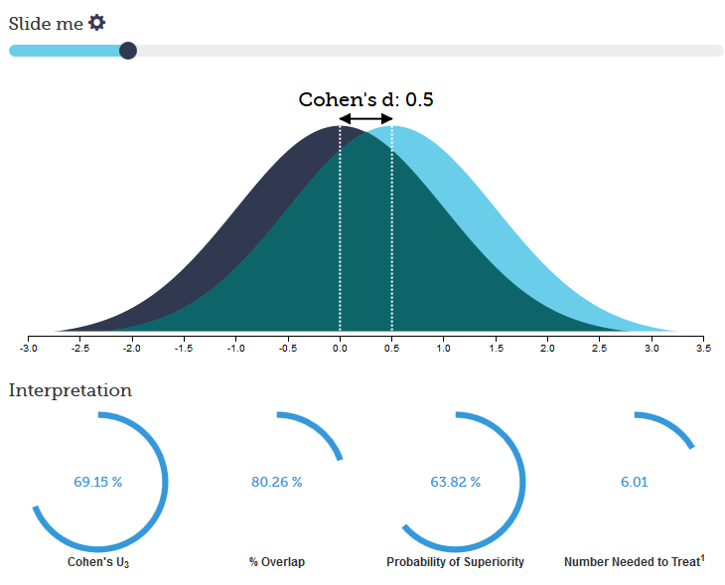
Nice interactive website
http://rpsychologist.com/d3/cohend/

Slide 85
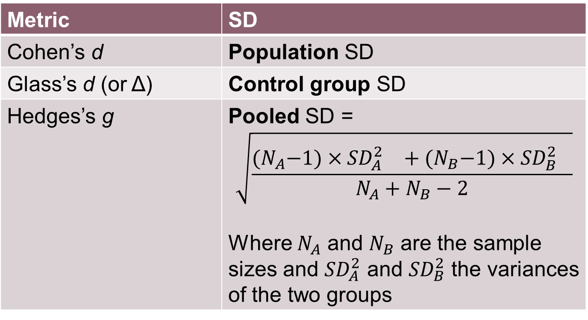
Which SD?
Metric | SD
Cohen’s d | Population SD
Glass’s d (or Δ) | Control group SD
Hedges’s g | Pooled SD = $$\sqrt{\frac{{(N}_{A}−1)×{{SD}_{A}^{2}}^{}+{(N}_{B}−1)×{{SD}_{B}^{2}}^{}}{N_{A}+N_{B}−2}}$$ Where $N_{A}$ and $N_{B}$ are the sample sizes and ${SD}_{A}^{2}$ and ${SD}_{B}^{2}$ the variances of the two groups

Slide 86
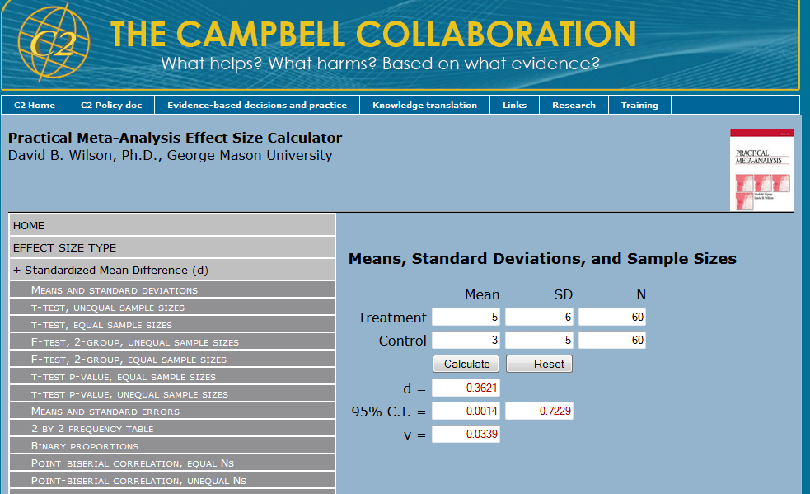
Useful website for doing the sums http://www.campbellcollaboration.org/resources/effect_size_input.php

Slide 87
Where do we get the effect size from?
“Hang on… if I knew the effect size then I wouldn’t need to run the study!”
Idea is to anticipate what you might find
Look at similar results in the literature (more on which later)
Try to improve upon an existing intervention (what was the average effect size?)

Slide 88
Power in a slide
Expressed as a probability or percentage
Usually we want at least 0.8 (or 80%)
Which means that if you were to run lots and lots of studies with the same sample size…
… and if the true (population) effect size were as you hypothesised…
Then around 80% of the studies would find a statistically significant effect

Slide 89
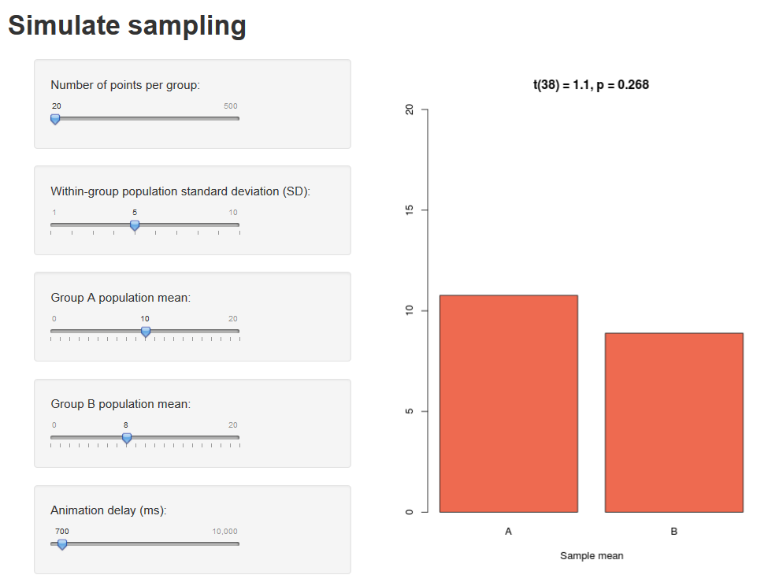
Demo https://andyf.shinyapps.io/sampling

Slide 90
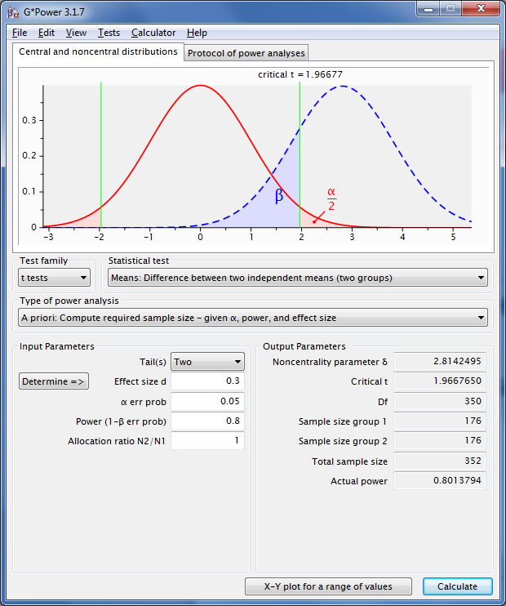

Slide 91
What test?
What do you want to calculate?

Slide 92
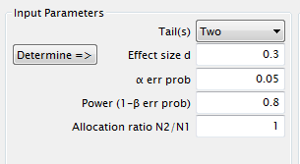
What settings? (d = 0.3, power = 80%, looking for p < .05, and with equal-sized groups)

Slide 93

The answer

Slide 94

Another standardised effect size: r

Slide 95


Slide 96
What test?
Correlation is a special case of regression
What do you want to calculate?

Slide 97

What settings? (r = 0.3, power = 80%, looking for p < .05)
H0 = null hypothesis of no correlation
Correlation between X and Y is same as regressing X on Y with both rescaled to have SD = 1

Slide 98

The answer

Slide 99

Example of effect sizes from the literature – social psych (Richard, Bond, & Stokes-Zoota, 2003)

Slide 100

(Richard, Bond, & Stokes-Zoota, 2003)

Slide 101

Morris and Fritz (2013) do it for memory research and produce percentile tables

Slide 102

Other example: Teacher effects uncovered by Hattie (2009)

Slide 103
Other example: Teacher effects uncovered by Hattie (2009)

Slide 104
Other example: Teacher effects uncovered by Hattie (2009)

Slide 105
Other example: Teacher effects uncovered by Hattie (2009)

Slide 106
Other example: Teacher effects uncovered by Hattie (2009)

Slide 107



Further reading on the EPRM wiki https://wiki.ucl.ac.uk/display/EPRM

Slide 108
The end!

